Slide 1

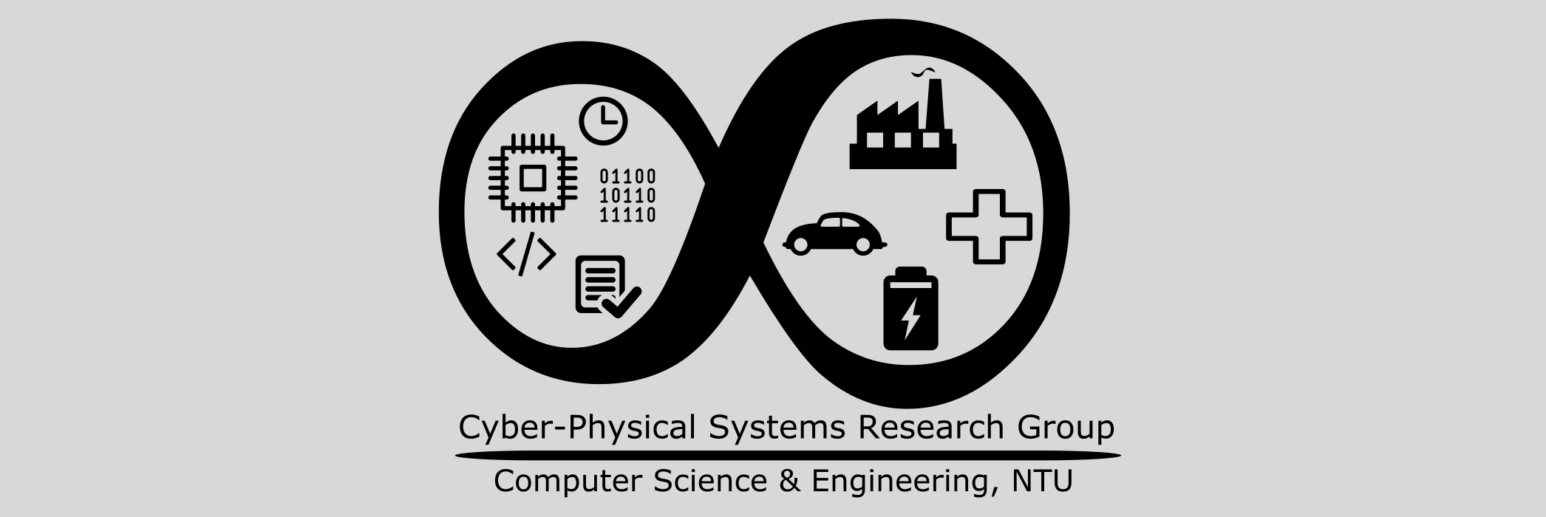
Using Pretrained Models

Slide 2
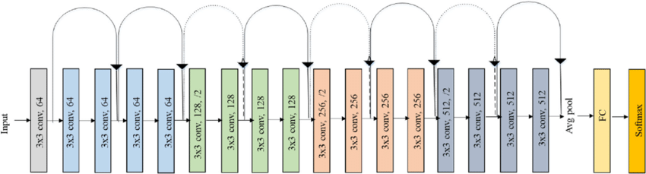
Resnet
[10] S. Igbal, Original Resnet-18 Architecture
We can go deeper, but we suffer the vanishing gradient problem
Resnet solves this with skip connections
Comes in variants from 18 layers to over 100
However, this comes at a cost of training time

Slide 3
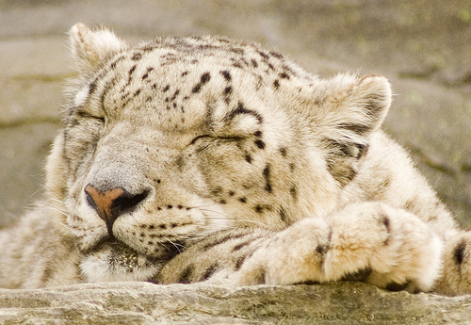
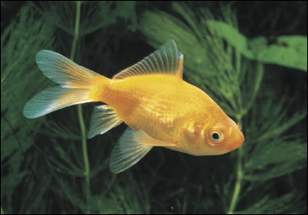
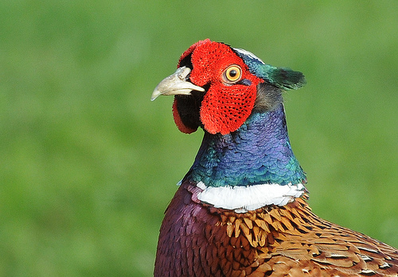
ImageNet
Benchmark dataset for color image classification
Over 1000 classes
1,281,167 training images
50,000 validation images
100,000 test images
[11] ImageNet

Slide 4
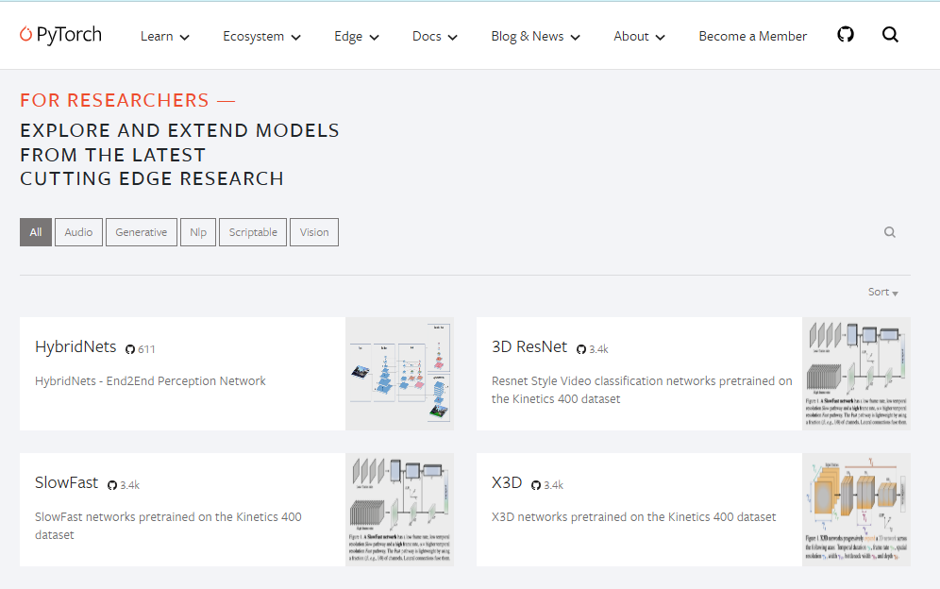
Exercise 4: Load a Pretrained Model from TorchHub
Let’s use a more complex classification model…

Slide 5
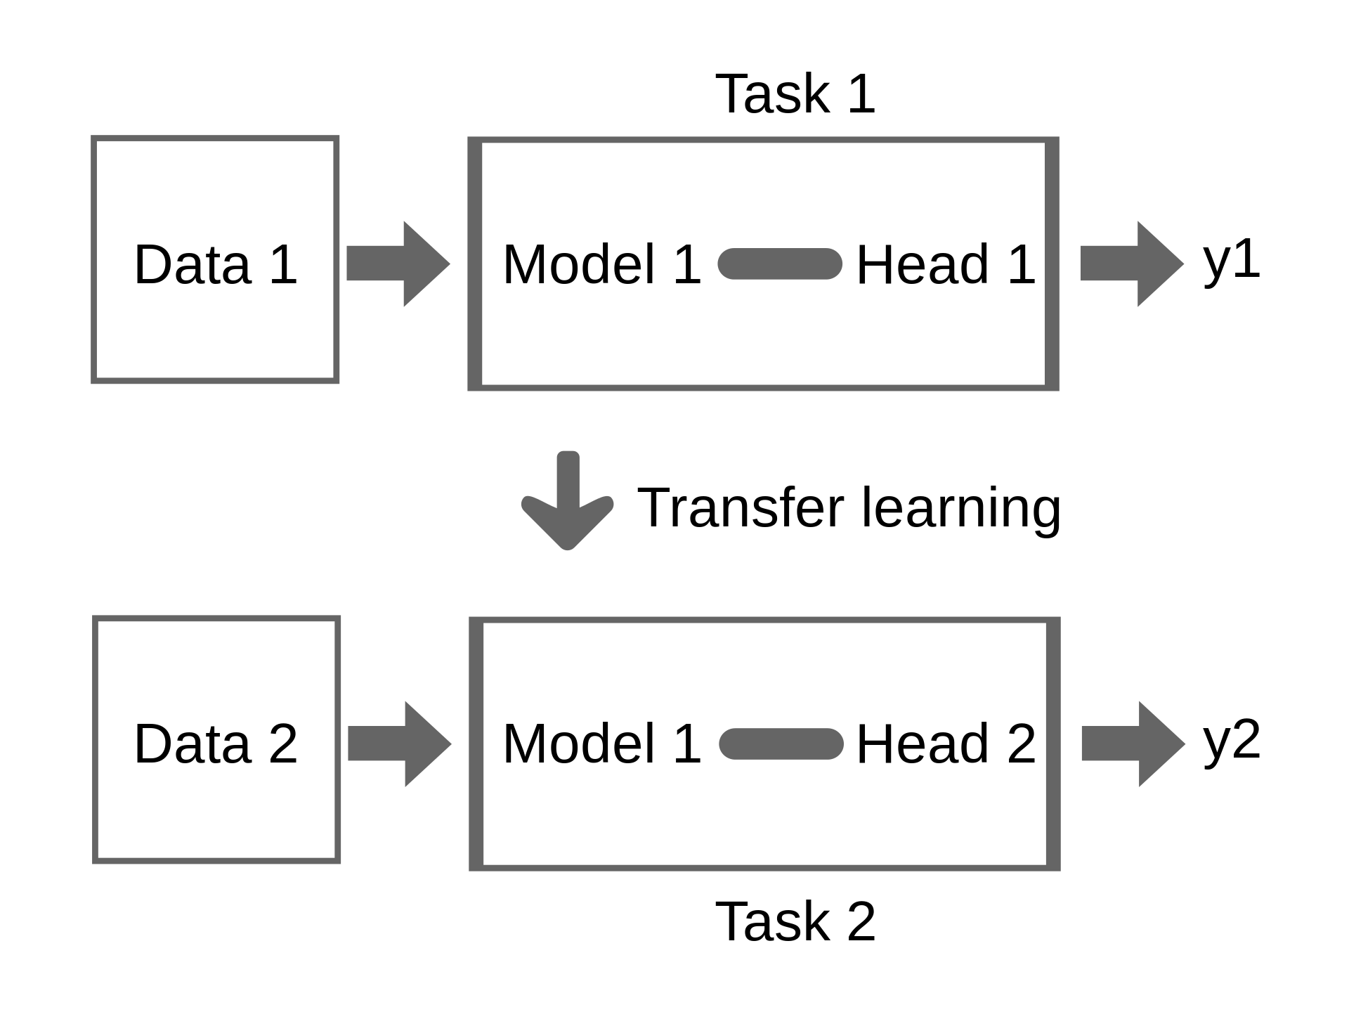
Transfer Learning
Use a model trained on one dataset to make predictions on another dataset
We need to fine tune on some data from the second dataset
Can greatly reduce training time
[12] Biggerj1, Illustration of Transfer Learning

Slide 6
Three Categories of Transfer Learning
Depending on the task and the amount of labeled/ unlabeled data available for source and target domains, transfer learning methods fall into one of three categories: inductive, transductive, and unsupervised.
Category | Source data labeled? | Target data labeled?
Inductive | Can be labeled and unlabeled | Yes
Transductive | Yes | Yes/No
Unsupervised | No | No

Slide 7
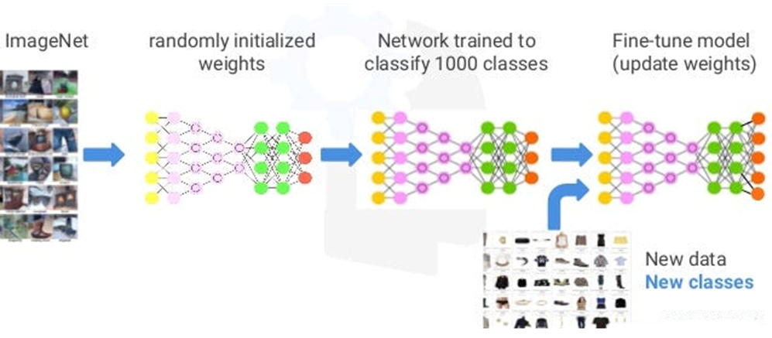
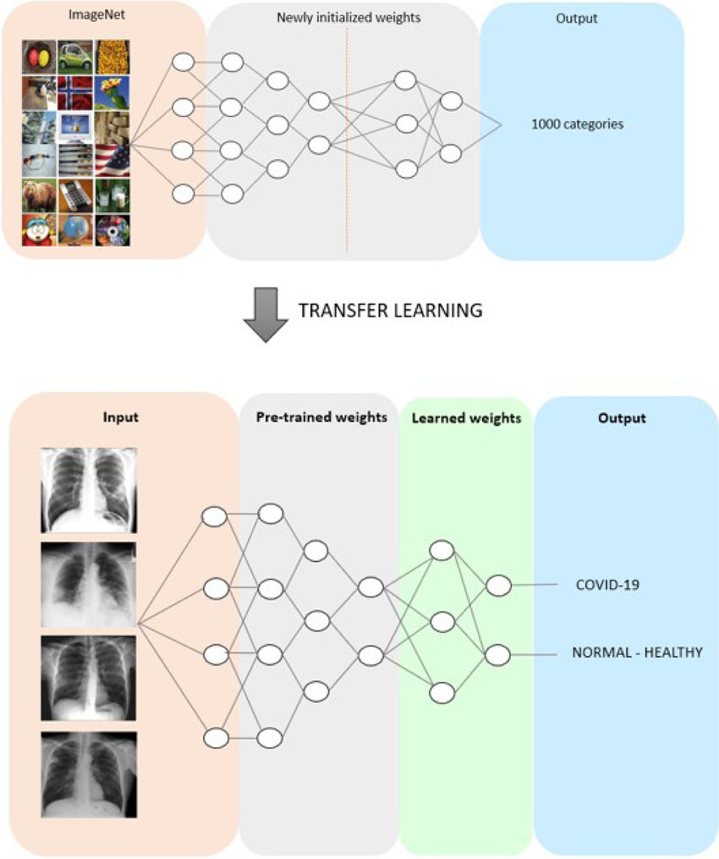
Transductive
Inductive
http://dx.doi.org/10.1016/j.jjimei.2021.100020
https://madhuramiah.medium.com/deep-learning-using-resnets-for-transfer-learning-d7f4799fa863

Slide 8
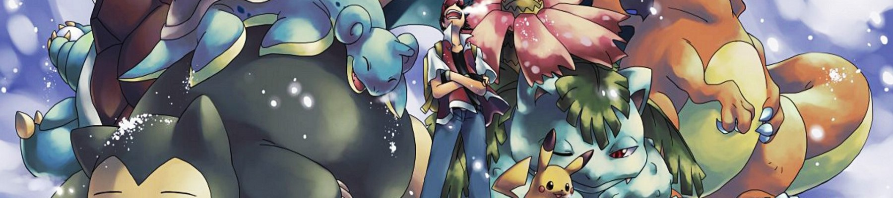
Exercise 4 ctd: Transfer Learning
Can you fine-tune ResJet to classify images of Pokemon?
[13] R. Banik, The Complete Pokemon Dataset, Kaggle (2018)

Slide 9
Semantic Segmentation with CNNs

Slide 10
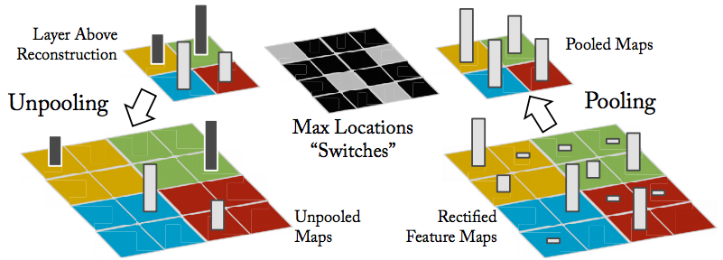
Unpooling
[14] Visualizing and Understanding Convolutional Neural Networks, CMU (2016)
If we can reduce dimensions, we can also increase them
Usefull for image generation, augmentation, and segmentation

Slide 11
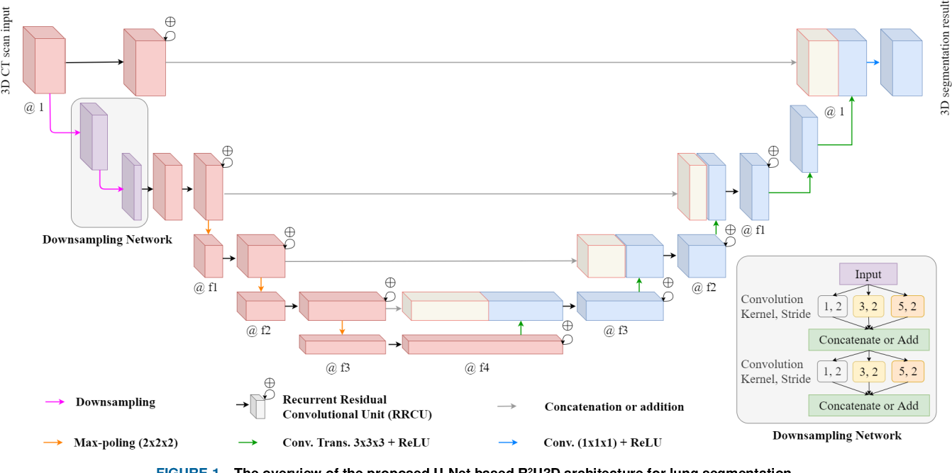
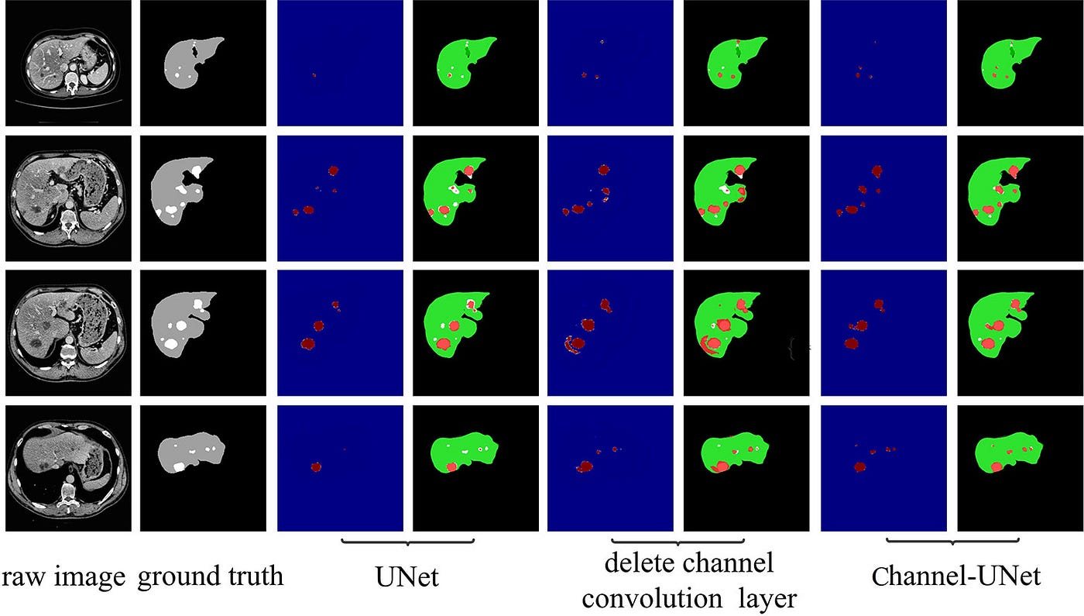
U-Net
An Image Segmentation Architecture
Classify each pixel in an input image
Useful for lane detection, medical imaging, etc.
[15] A. Quesada, U-Net: A Versatile Deep Learning Architecture for Image Segmentation, Medium (2023)

Slide 12
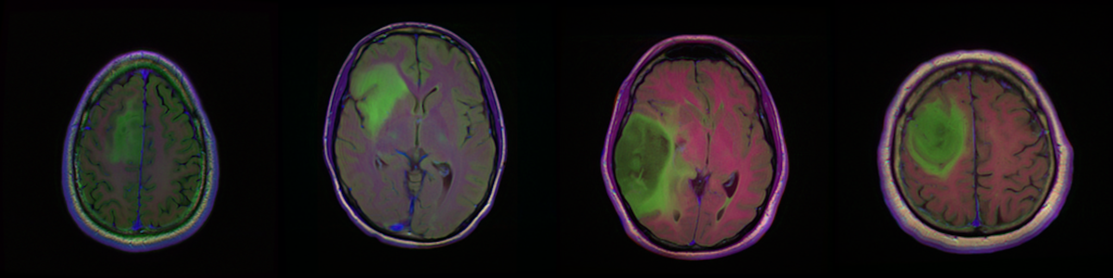
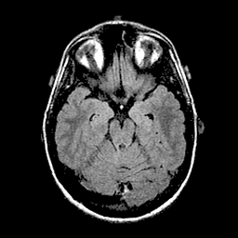
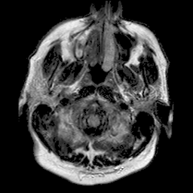
Exercise 5: Segmentation
Let’s look at how U-Net can be used for FLAIR abnormality segmentation in brain MR

Slide 13
Image Generation with Diffusion Models

Slide 14
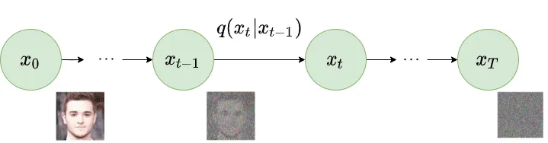
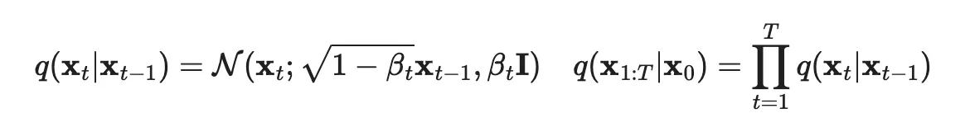
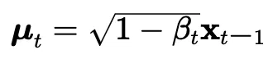
Diffusion models work in a dual-phase mechanism:
Train a neural network to introduce noise into the dataset
https://www.superannotate.com/blog/diffusion-models

Slide 15
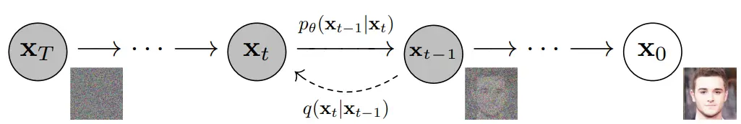
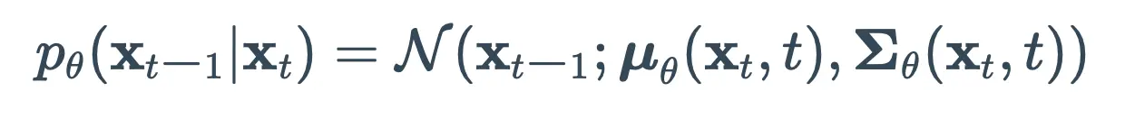
Diffusion models work in a dual-phase mechanism:
Methodically reverse this process.
We can't directly calculate q(xt−1∣xt) because it involves complex data-related calculations. Instead, we use a model (like a neural network) to estimate q(xt−1∣xt).
https://www.superannotate.com/blog/diffusion-models

Slide 16
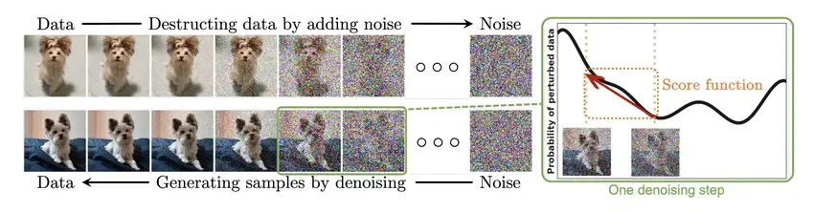
Exercise 6: Diffusion
Let’s look at a minimal example of the forward diffusion process and its reverse mapping using a dense network.
https://www.superannotate.com/blog/diffusion-models

Slide 17
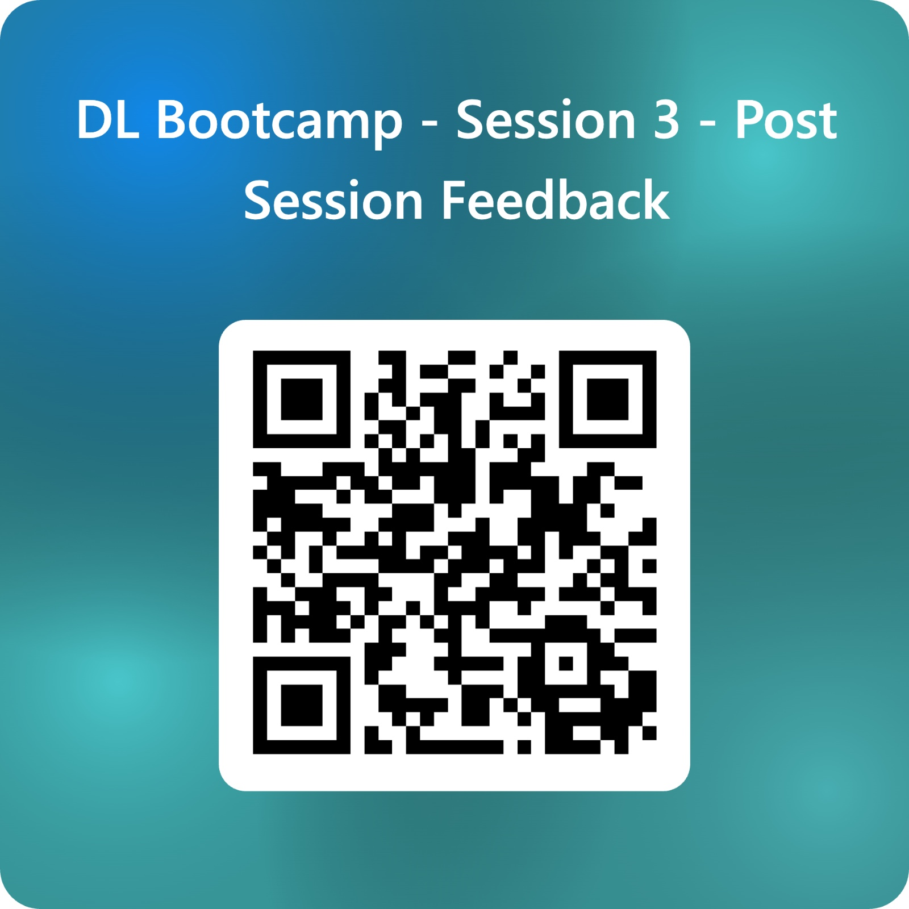

Slide 18
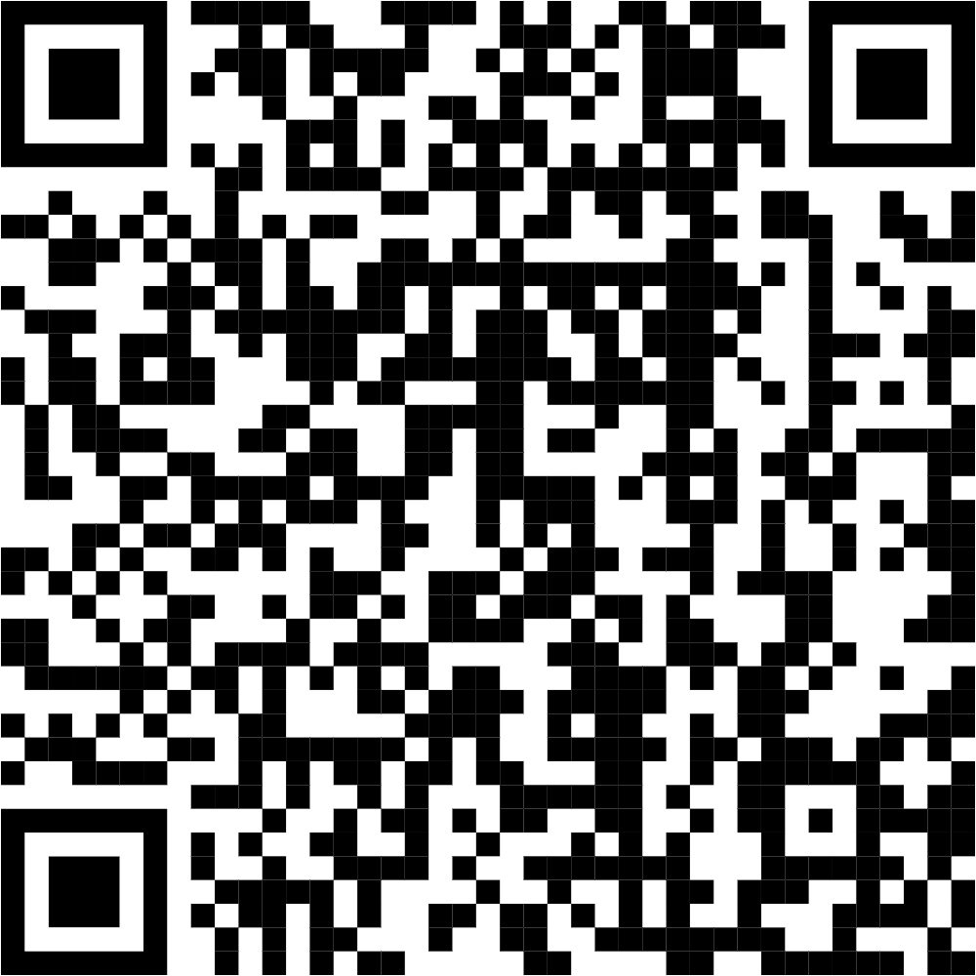
Session 4: Natural Language Processing
Register for the next session to learn about how deep learning can help with natural language processing!
We cover Recurrent Neural Networks (RNNs), Long Short-Term Memory (LSTMs) and Transformers (GPTs and LLMs).
Date: 14th March 2025
Time: 2:00pm to 5:00pm

